Slide 1



Last Minute Study

Slide 2


Introduction to Application
Introducing a revolutionary Platform designed to assist users with last-minute studying seamlessly across both websites and mobile apps.

Slide 3

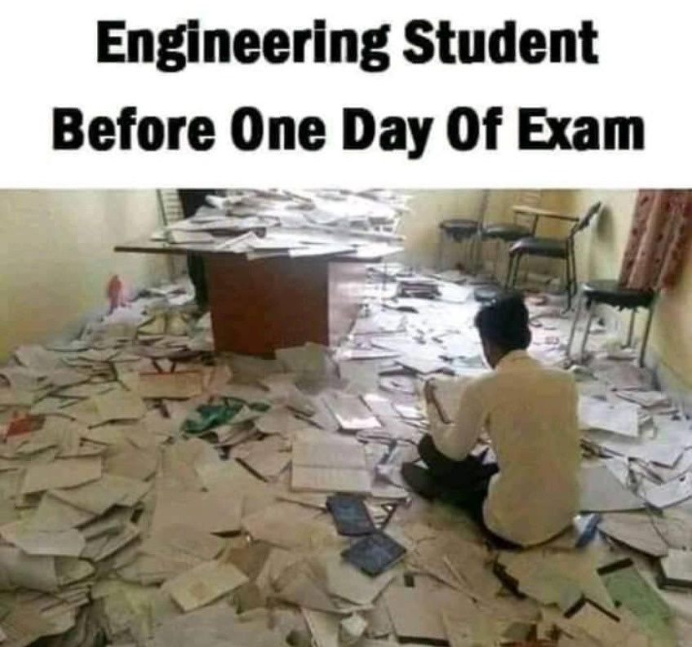
Problem Statement
Within the university, engineering students have a common tradition:
Cramming at the last minute. Many people, even with the greatest of intentions and preparation, find themselves having to review the entire semester's material in the
final few hours before an exam.

Slide 4

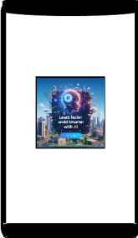
Understanding Application
AI study material creator and roadmap creator.
Connect with like minded people.
Community building with ai bots.
Available on “ iOS ” and “ Android ” both.

Slide 5


Benefits of Application
Input your subjects and syllabus on the website.
Receive a personalized study roadmap based on the syllabus and available time.
The roadmap is optimized to cover the syllabus efficiently as per given Time.
Access study materials such as YouTube videos recommended for each topic.
Practice questions are provided to enhance understanding.
Everything is tailored to the remaining time before your exam.

Slide 6

Thank You

